Slide 1
CFB Visualization Tool
CS5010 Semester Project
Drew Haynes, Sarah Rodgers, Thomas McIntyre

Slide 2
Overview
Introduction
Data (Data set and Web Scraping)
Data Cleaning and Merging of Data Sets
Dash package and Visualization Application
Live Demonstration
Results/Next Steps

Slide 3
Introduction
College Football is something that almost everyone has experienced
The data available within college football is all over
Data for an everyday fan (Wins, Losses, Yards)
Data for a coach or football enthusiast (Yards after contact, Defensive Efficiency)
Our group shared a common interest in college football
Interested in ways of how we could visualize the data in a user friendly way.
We decided to collect data from several sources, and create an interactive college football application

Slide 4
Dataset Kaggle
The original data set used in our project came from Kaggle which had over 100 college football statistics columns for the years since 2013
This massive amount of data stemmed the idea of visualizations
The data from this set was rather clean and most years had the same exact columns.
Some data wrangling was needed using pandas to standardize the data across years
I.e. some school names used “St” instead of “State” or vice versa

Slide 5
Data - Web Scraping
Use of Beautiful Soup to web scrape the following:
Logos from ESPN’s College Football Power Index (FPI) 2020
School name and mascot from Wikipedia’s List of NCAA Division I FBS Football Programs
Using the information created from the web scraper data frame we were able to then map the data to our kaggle data frame using school names.

Slide 6
Merging of data sets
Name discrepancies
When merging the web scraped data and the kaggle data, abbreviated school names were standardized
"App State (Sun Belt)":"Appalachian State (Sun Belt)"
"Central Mich. (MAC)":"Central Michigan (MAC)"
Unit Tests run on the datasets
Since the main product of our project is the data visualization tool we had to make sure the tool was receiving and outputting the correct data
Ran multiple unit tests on each of the data frames to ensure the tool was reporting the data we anticipated

Slide 7
Dash Python Package
Allows for flexible and reactive web applications to be created for data analysis, exploration, and visualization.
The tool is completely user dependent to produce visualizations
Using the 4 drop down menus to alter the outputs on the scatterplot
Then using your mouse to hover or click on the team logo you want to see in the time series plots
To compensate for some of the years having variables that may not be in another year, the plots default to a valid selection.
There are only a few variables found in unique years of the 100+ available

Slide 8
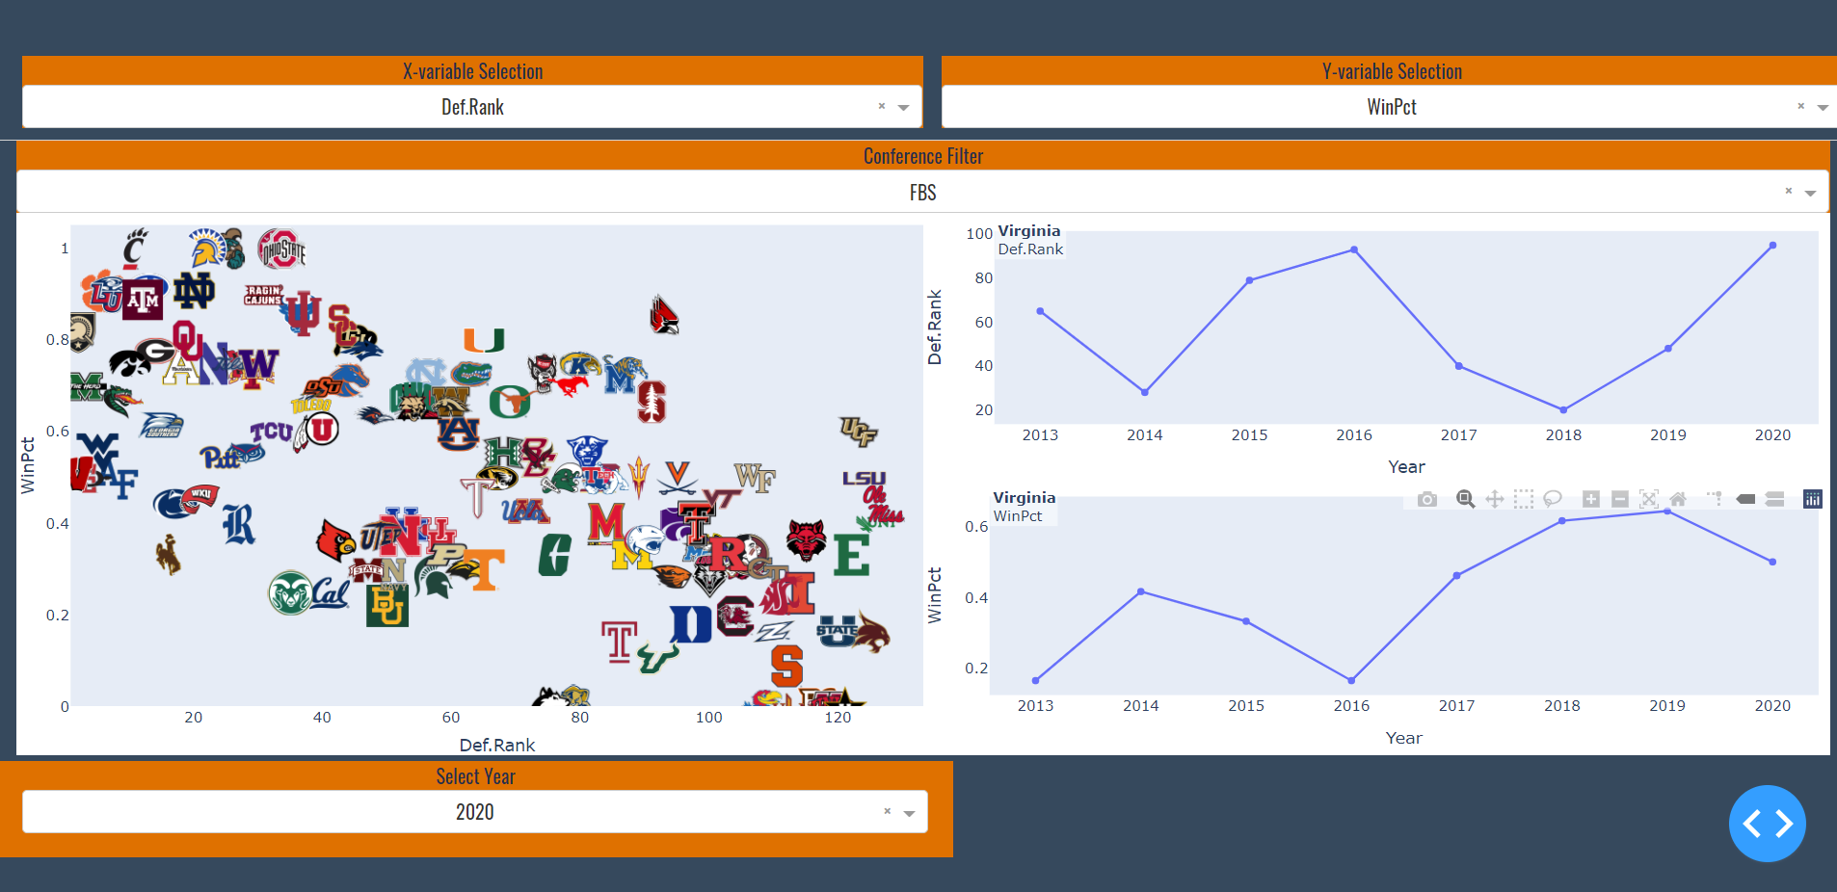
Visuals within the application

Slide 9
Results
Dash was a useful tool in creating a data visualization tool
Useful for exploration for data sets with many variables
The tool and project could easily be used in other domains
The app would be interesting for any college football fan

Slide 10
Conclusion/Next steps
Tools used from CS5010 for a successful project
Basic python skill/knowledge of syntax
Pandas data manipulation
Unit Testing
Defining methods
Data visualization
Web scraping
A potential next step for this project would be to have the application be able to easily take in any dataset (of a different domain) and be able to function properly.

